Slide 1
Visualizing Two Social Networks Across Time with SAS®:
Collaborators on a Research Grant vs. Those Posting on SAS-L
Larry Hoyle
Institute for Policy and Social Research
University of Kansas

Slide 2
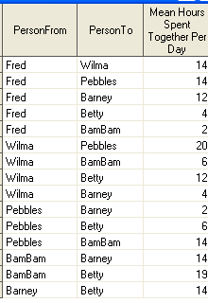
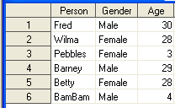
Visualize These Data
Links
Nodes

Slide 3
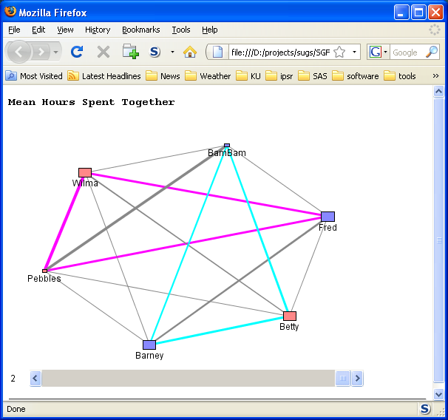
A Social Network

Slide 4
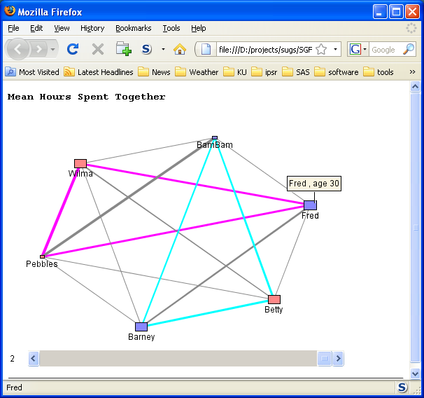
Constellation Chart: Nodes
Nodes Have:
Size (age)
Color(gender)
Tip (text)

Slide 5
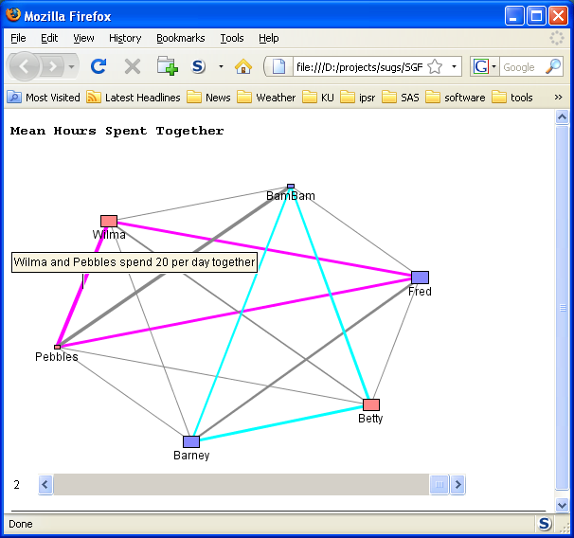
Constellation Chart Links
Links Have:
Width (Hours)
Color(family)
Tip (text)

Slide 6
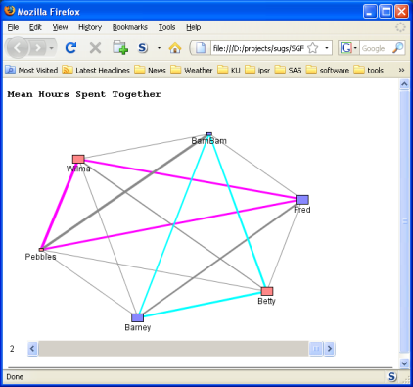
Social Network Graph
Two SAS tools:
Constellation Chart Applet (and Macro)
Annotate File

Slide 7
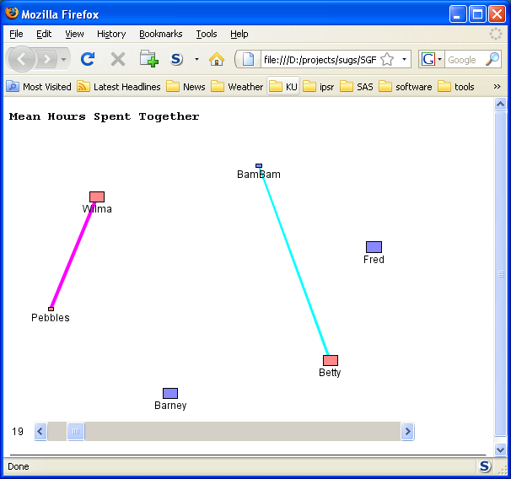
Constellation Chart Slider
Slider set to show only links with 19 or more hours spent together

Slide 8
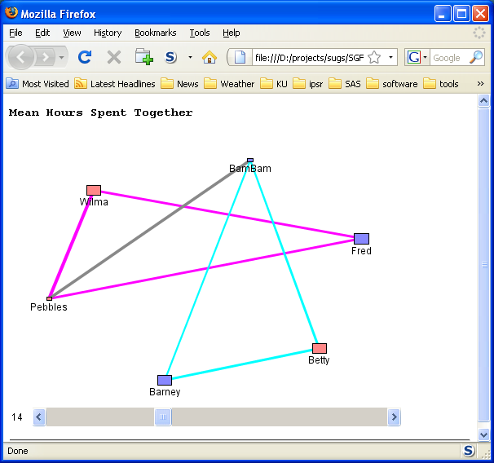
Constellation Chart Slider
Slider set to show only links with 14 or more hours spent together

Slide 9
Constellation Code
title 'Mean Hours Spent Together';
%ds2const(
ndata=Flints, ldata=FlintTimes, datatype=assoc,
minlnkwt=30, height=360, width=480,
codebase=&jarpath, htmlfile=&outfile,
colormap=y, fntsize=12,
nid=Person, nlabel=Person, nvalue=age,
ncolor=gender, ncolfmt=Gcolor., ntip=ntip,
lfrom=PersonFrom, lto=PersonTo, lvalue=MeanHours,
linktype=line, lcolor=linktype, lcolfmt=Lcolor.,
ltip=ltip, sclnkwt=N);
Files
Appearance
Nodes
Links

Slide 10
Two Different Sets of Data
Each With Their Own Challenges
SAS-L (the SAS Listserv)
  Nodes are email addresses of posts (23,827)
  Links are posts to the same thread in the same year (267,209 messages to 82,279 threads ).
Kansas NSF EPSCoR Grant
  Nodes are projects and nodes are people
    People have different roles (PI, researcher, support staff)
  Multiple types of links, together on:
    authorship, proposals, listed together in narrative
  Changes across time

Slide 11
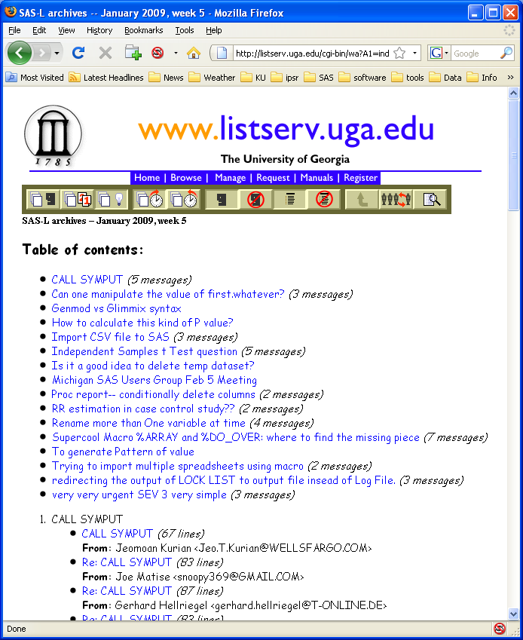
SAS-L Data – Available on the Web
Data Cleaning –
Addresses Change
Linked-
posting to the same thread

Slide 12
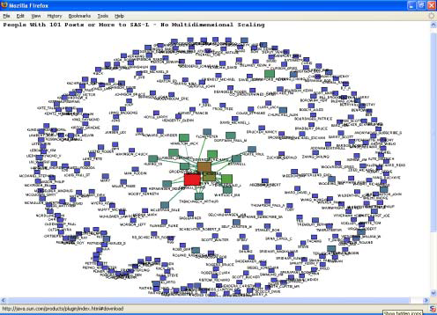
SAS-L - Too Many Nodes for Applet
Approach: Limit the number of nodes

Slide 13
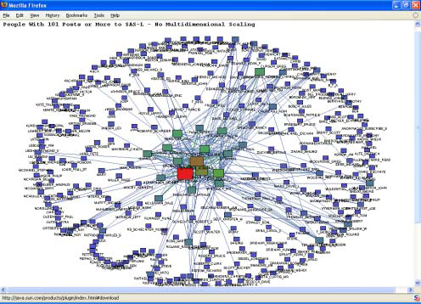
SAS-L Those With Over 100 Posts

Slide 14
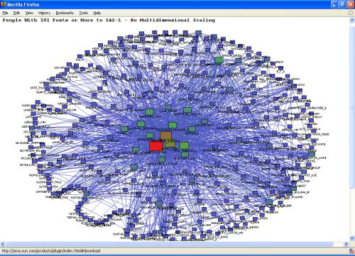
Most Links are With a Core Group

Slide 15
Too Many Nodes for Applet
Approach: Display All w/ SAS Annotate File

Slide 16
SAS Annotate File – Arrange Nodes
How do you arrange the nodes in some meaningful way?
  All Nodes Around a Circle or
  Multidimensional Scaling of some or all nodes
proc mds
data=SGF2009.TOPPOSTERSSIMILARITY
out=SGF2009.TopPosters2D
similar
dimension = 2
level=ordinal;
run;

Slide 17
Problem: MDS on 23K nodes?
  Scale the nodes with the most links
  (shown in red)
  Arrange the others randomly in a circle around them
  (shown in gray)
  Links to red nodes in blue, others in black

Slide 18
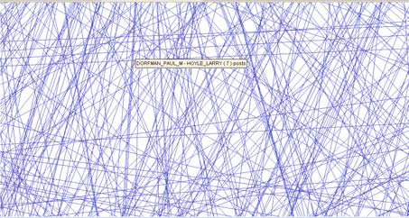
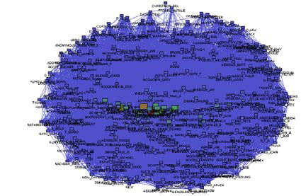
Zoom and Pan With Applet
With annotate – Vector output (E.G.) RTF would allow zoom, but not tip on links

Slide 19
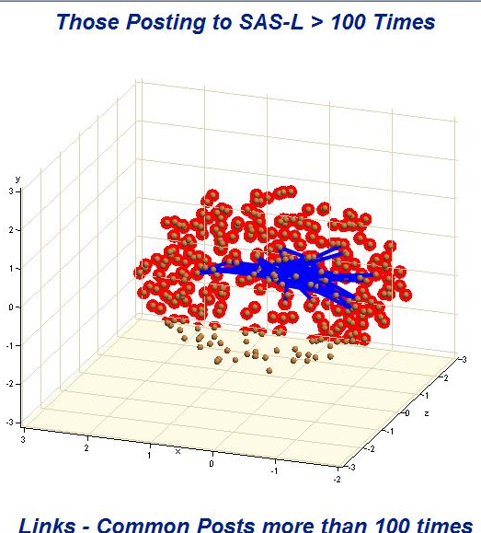
3D with PROC G3D and Annotate
ActiveX and Java Devices Only

Slide 20
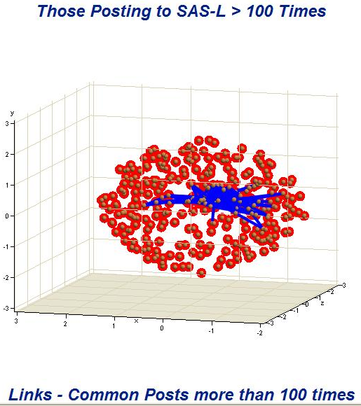
3D with PROC G3D and Annotate
Generated in SAS 9.2

Slide 21
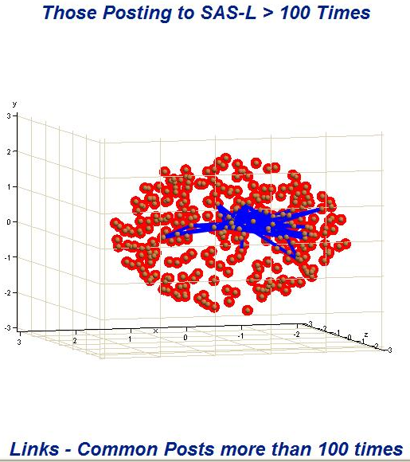
3D with PROC G3D and Annotate
Generated From EG 4.1

Slide 22
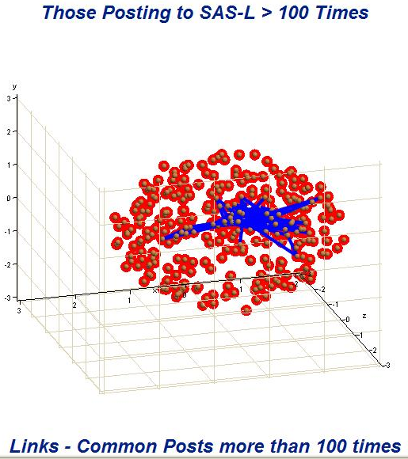
3D with PROC G3D and Annotate
ActiveX and Java Devices Only

Slide 23
Kansas NSF EPSCoR Phase V
Visualization Needs
Show relationships among 247 people
And among 50 projects
Show change in collaboration across time
Differentiate core people
Differentiate principal investigators (Pis)
Differentiate institutions
Animate across time

Slide 24
Projects Layer Arranged by
People in Common Across all Years

Slide 25
Core People Layer Arranged by
Centroid of Projects to Which They Belong

Slide 26
People and Links
People
  Color indicates institution
  White dot is Principal Investigator
  Size is count (e.g. publications)
  Large tan dot indicates core person
Links
  Width represents count in common

Slide 27
People in Fixed Positions
Allows Animation Across Time (2006)

Slide 28
People in Fixed Positions
Allows Animation Across Time (2007)

Slide 29
People in Fixed Positions
Allows Animation Across Time (2008)

Slide 30
Other Comparisons –
All Proposals and Submissions

Slide 31
Other Comparisons –
Successful Proposals

Slide 32
Other Comparisons –
Proposals

Slide 33
Other Comparisons –
Scientific Product

Slide 34
Other Comparisons –
Combined

Slide 35
Method Comparisons
Applet
  Coding is Quick
  Slider
  Link Tips
  Memory Limits
  Screen Capture to Publish
  Dynamic Pan and Zoom
  Data Driven Color and Size
Annotate
  Additional Data Steps
  Animated GIF
  HTML Link Tips (Difficult)
  Many Nodes Possible
  High Quality Reproduction
  No Tips (ODS Vector Output)
  Richer Symbology

Slide 36
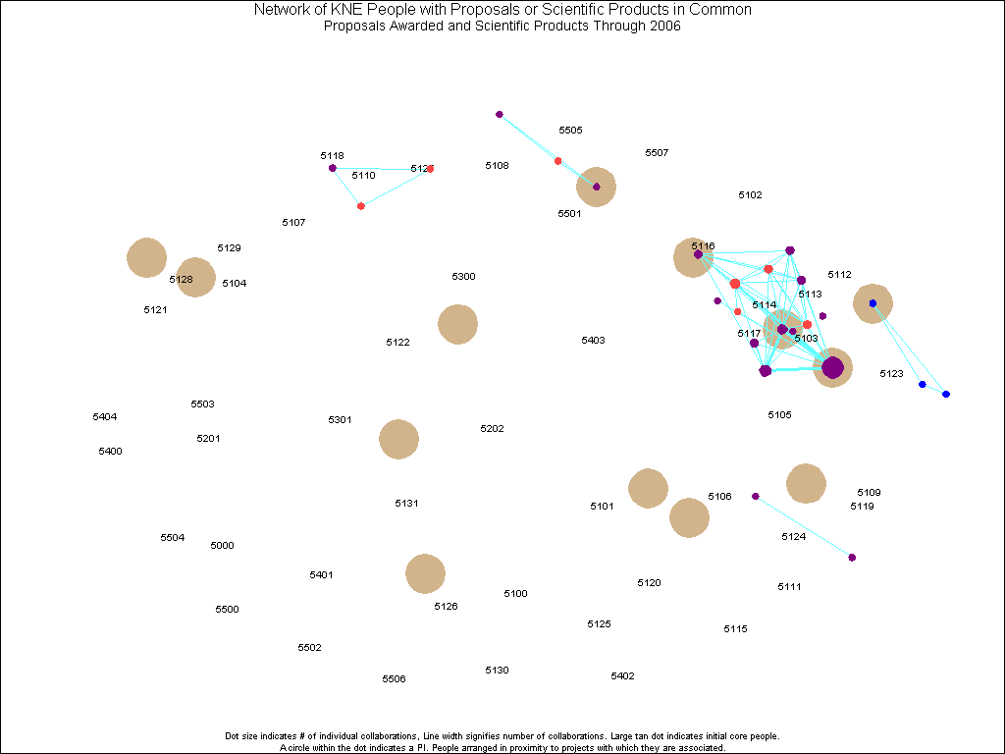
Animation Issues – Fix Node Position
  Fix the position of nodes across all frames
  Arrange in circle
  Dimension reduction (MDS?)
  Example: KNEGIF.htm

Slide 37
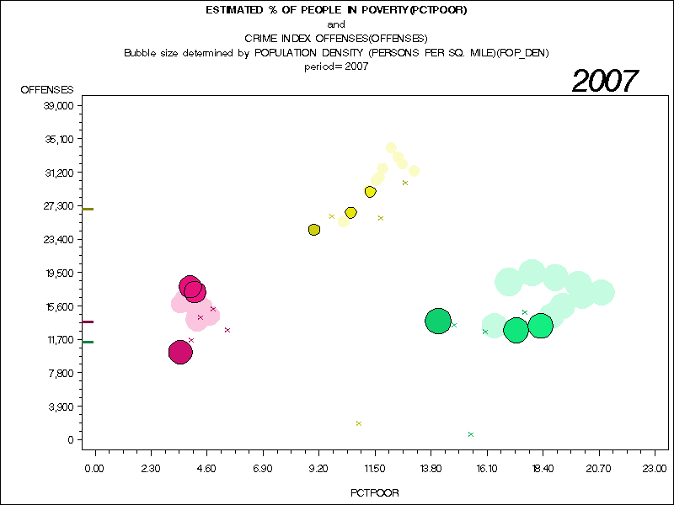
Animation Issues - Interpolation
Dimension reduction that preserves orientation - then interpolate between observations
SAS Example:
could do something like
Kansas Data Archive Bubble Plots
Chart from http://www.ipsr.ku.edu/ksdata/
Inspired by Trendalyzer Software http://www.gapminder.org

Slide 38
Other Tools
SAS Graph NV Workshop
Enterprise Miner
  See paper 109-2009
  Barry de Ville, Discover and Drive Brand Activity in Social Networks

Slide 39
Statistics - Clustering
Clustering Coefficient
  Global
  Proportion of triads that have third link
A
When BA and BC are present,
Is AC present?
B
?
C

Slide 40
Statistics - Betweenness
Betweenness Centrality
  Individual
  Sum of proportion of shortest paths that go through a given link
x
w
v
z
y
Contributing to Centrality for v –
wvz and wxz – v is central 1 of 2 shortest w-z paths

Slide 41
Statistics - Betweenness
Betweenness Centrality
  Individual
  Sum of proportion of shortest paths that go through a given link
x
w
v
z
y
Contributing to Centrality for v –
wvz and wxz – v is central in 1 of 2 shortest w-z paths
wvy - v is central in 1 of 1 shortest w-y paths

Slide 42
Statistics - Betweenness
Betweenness Centrality
  Individual
  Sum of proportion of shortest paths that go through a given link
x
w
v
z
Contributing to Centrality for v –
wvz and wxz – v is central in 1 of 2 shortest w-z paths
wvy - v is central in 1 of 1 shortest w-y paths
wx – v is central in 0 of 1 shortest w-paths
y

Slide 43

Questions?
Larry Hoyle
LarryHoyle@ku.edu

