Slide 1
Web Maps with Leaflet
GEOG 319/658
November 24, 2014

Slide 2
Steps
Planning
Data & Metadata
Geography
Programming
Feedback, repeat as needed

Slide 3
Planning
Start by outlining the project:
What is the purpose of the map?
Who are the intended users?
What features are needed?

Slide 4
Data & Metadata
Gather data
Gather or produce metadata
Design and create MySQL tables

Slide 5
Geography
Define geographic scope/scale of map
Determine required map layers
Collect boundaries or XY data
Convert boundary data, as needed

Slide 6
Programming
Write code
Write more code
Test
Write more code

Slide 7
Specifics
Notes:
http://ipsr.ku.edu/ksdata/apps/KCMOtracts.php
Focus on specific implementation of Leaflet that draws on core American Community Survey data for Census Tracts in the Kansas City, MO metro area.

Slide 8
MySQL
Relational database with
4 tables for data
1 table for metadata
1 table for boundaries
Notes:
http://www.mysql.com/

Slide 9
MySQL
Social Characteristics (DP2)
GEOID
GEOID2
GEOLABEL
HC01_VC03
…
HC04_VC209
Economic Characteristics (DP3)
GEOID
GEOID2
GEOLABEL
HC01_VC04
…
HC04_VC175
Housing Characteristics (DP4)
GEOID
GEOID2
GEOLABEL
HC01_VC03
…
HC04_VC199
Demographic Characteristics (DP5)
GEOID
GEOID2
GEOLABEL
HC01_VC03
…
HC04_VC98
Metadata
File
Type
Variable
Description
Units
dec_places
Universe
Topic
Detail1…Detail4
Boundaries
GEOIDTXT
GEOIDNUM
Name
INTPTLAT
INTPTLON
COORDINATES
COORDINATES2

Slide 10
MySQL
Social Characteristics (DP2)
GEOID
GEOID2
GEOLABEL
HC01_VC03
…
HC04_VC209
Economic Characteristics (DP3)
GEOID
GEOID2
GEOLABEL
HC01_VC04
…
HC04_VC175
Housing Characteristics (DP4)
GEOID
GEOID2
GEOLABEL
HC01_VC03
…
HC04_VC199
Demographic Characteristics (DP5)
GEOID
GEOID2
GEOLABEL
HC01_VC03
…
HC04_VC98
Metadata
File
Type
Variable
Description
Units
dec_places
Universe
Topic
Detail1…Detail4
Boundaries
GEOIDTXT
GEOIDNUM
Name
INTPTLAT
INTPTLON
COORDINATES
COORDINATES2
Notes:
Variables in red and green link these tables together to either associate the data with the correct boundary (red) or lookup metadata about a variable (green).

Slide 11
SQL
SELECT *
FROM ACS12_METADATA
Returns all 2,035 rows and 12 columns in this table
Notes:
The * is a wildcard meaning get all columns.

Slide 12
SQL
SELECT Description
FROM ACS12_METADATA
WHERE FILE="DP02" AND variable="HC01_VC03";
Notes:
SQL example to retrieve one cell from a table.

Slide 13
SQL
SELECT a.namelsad, b.HC01_VC03, c.*
FROM GeoJSON_Tracts AS a,
ACS12_5YR_DP02 AS b,
ACS12_METADATA AS c
WHERE b.geoid2=20209042002 AND b.geoid2=a.geoidnum AND c.variable="HC01_VC03" AND c.file="DP02"
Notes:
SQL example to retrieve one variable from the boundary table, one variable from a data table, and all variables from the metadata table for a specific census tract and data item. This is meant to illustrate the use of table aliases. I’ve used a, b, and c but you can use anything without a space or symbol.

Slide 14
Excel: friend or foe?
Notes:
Reference Peterson text figure 17.5 on page 330. The INSERT INTO code shown in figures 17.5 and 17.7 could be easily generated from an Excel table containing the city names and coordinates.

Slide 15
Excel: friend or foe?
Notes:
Here Excel has chopped off the GeoJSON coordinate string causing a loss of data.
Maximum string length in Excel is 32,767 characters.
MySQL text field limit is 2^16 or 65,535 characters.

Slide 16
GeoJSON
GeoJSON is a format for communicating geographic data that includes some properties and pairs of coordinates.
A point can be simply represented as
[-104.99404, 39.75621]

Slide 17
GeoJSON
A line can be represented as
[
[-105, 40],
[-110, 45],
[-115, 55]
]

Slide 18
GeoJSON
A polygon can be represented as
[[
[-104.05, 48.99],
[-97.22, 48.98],
[-96.58, 45.94],
[-104.03, 45.94],
[-104.05, 48.99]
]]

Slide 19
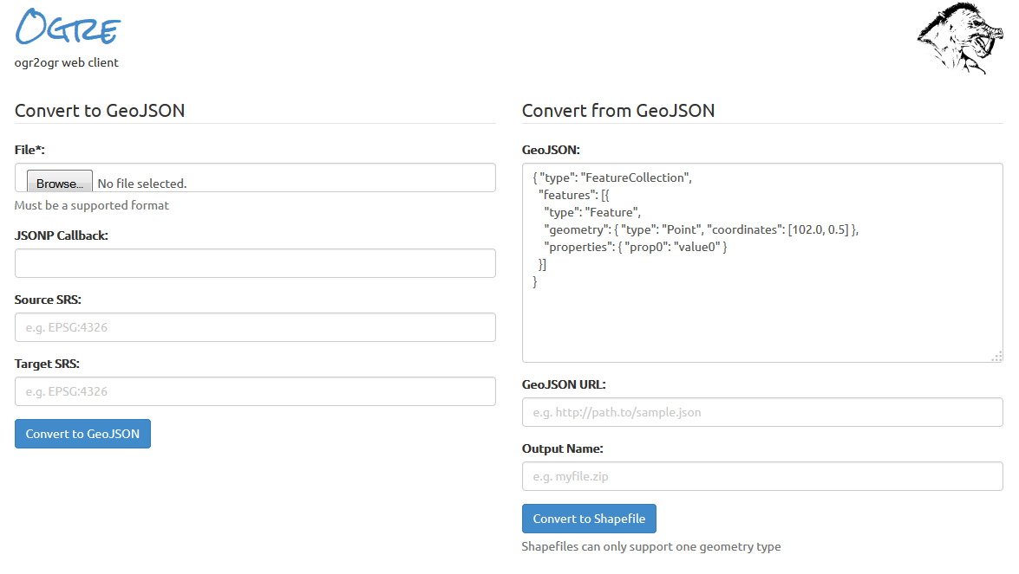
GeoJSON
http://ogre.adc4gis.com/
Notes:
In the case of KCMO, I didn’t have coordinates for the polygon boundaries I only had a shapefile from the U.S. Census Bureau. I was able to clip the shapefile in ArcGIS to the KCMO metro, but post-conversion filtering could occur in notepad.

Slide 20
Leaflet
Notes:
http://leafletjs.com/

Slide 21
Leaflet
Link to the Leaflet CSS

Slide 22
Leaflet
Link to the Leaflet JavaScript

Slide 23
Leaflet
Put a div element where you want the map on the page.

Slide 24
Leaflet
Start putting elements on you map.
Set view and scale
Background tile
Point
Circle
Polygon
Popup Event
Notes:
Leaflet Quick Start Guide Example - http://leafletjs.com/examples/quick-start-example.html

Slide 25
PHP
PHP works inside HTML and generates the page on the fly.
The simplest example is:
<html>
<body>
<? php echo “Hello World!”; ?>
</body>
</html>
Notes:
http://ipsr.ku.edu/ksdata/apps/leaflet.php?lat=38.958426&lon=-95.251558
Dynamic version of Leaflet quick start example where user can pass a latitude and/or longitude to place the point marker at given location.

Slide 26
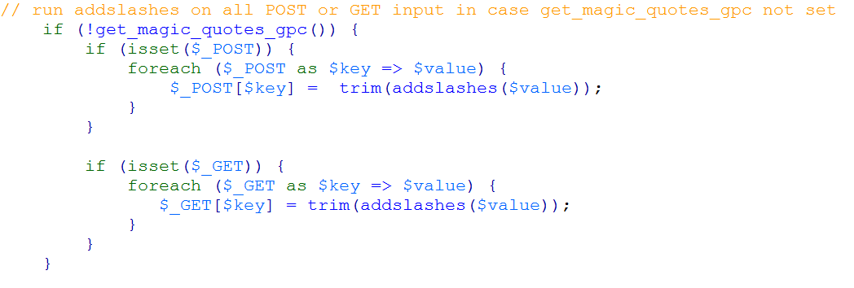
PHP
SAFETY PRECAUTION – if you allow users to enter anything, your application is open to hacking or malicious use. To help prevent misuse, escape potentially harmful characters and validate input.

Slide 27
PHP & Leaflet
http://ipsr.ku.edu/ksdata/apps/leaflet.php
Notes:
How might one validate latitude and longitude?
Suggest:
if (isset($_GET['lat']) && $_GET['lat']>=-90 && $_GET['lat']<=90) {
$mylat=$_GET['lat'];
}else $mylat=51.5;
if (isset($_GET['lon']) && $_GET['lon']>=-180 && $_GET['lon']<=180) {
$mylon=$_GET['lon'];
}else $mylon=-0.09;

Slide 28
PHP & Leaflet
http://ipsr.ku.edu/ksdata/apps/leaflet.php?lat=38.958426&lon=-95.251558

Slide 29
Putting it all together
Connect to MySQL
Run addslashes
Check for and validate user input
HTML/Javascript to set up page with Leaflet
Query MySQL
Use PHP to write Javascript for Leaflet based on query results

Slide 30
Connect to MySQL
Notes:
Reference Peterson text page 347. Author has put the connect code in a separate file and used an include. Here I have in the same file to show how to connect to a MySQL database.

Slide 31
Run addslashes (just in case)

Slide 32
Check for user input
Notes:
Note clr detected here but a change in choropleth map color is not yet implemented as a feature in this map. I have other maps where the default is blue but the use can select orange or green hues.

Slide 33
Set up HTML
Notes:
Call to Leaflet CSS and Javascript

Slide 34
Start Javascript
Notes:
Background tile and a function called myStyle which set the outline color, opacity, and calls another function called getColor which sets the color for each polygon.

Slide 35
Create classes
Notes:
Query db and calculate 5 equal interval classes.

Slide 36
Set colors and popup label
Notes:
Set the colors for each of the five classes and a function which sets the popup info for each polygon.

Slide 37
Query data & boundaries
Notes:
Here b and c are the same table, so this query could be improved by removing the reference to C and changing these to B since the data are stored in a wide table. If however, the data were stored a star schema format, separate calls would necessary.

Slide 38
Write out Javascript
Notes:
This looks awkward but it is just PHP writing out Javascript. Select View code in a browser window to see how this looks without all the PHP code.

Slide 39
Write out Javascript

Slide 40
var KCMOtracts =[{ "type": "Feature", "properties": { "STATEFP": "20",
"COUNTYFP": "059",
"TRACTCE": "954100",
"GEOIDTXT": "20059954100", "GEOID2":20059954100,
"GEOLABEL": "Census Tract 9541, Franklin County, Kansas",
"LABEL": "6,935 +/-312 ",
"VALUE": 6935}, "geometry": { "type": "Polygon", "coordinates": [ [ [ -95.056412, 38.738587 ], [ -95.056412, 38.737225 ], …, [ -95.056412, 38.738587 ] ] ] } }, … (repeat for 534 remaining Census Tracts)
Notes:
View of JavaScript being written by the PHP code from the previous two slides.

Slide 41
Test
Notes:
http://ipsr.ku.edu/ksdata/apps/KCMOtracts.php

Slide 42
Other types of coordinates
Notes:
The sample shows PHP writing Javascript for coordinates stored as single values (aka long, skinny table)

Slide 43
Other types of coordinates
Notes:
The sample shows PHP reading a GeoJSON feed from USGS. The data are already formatted so PHP just reads the data and writes it out.
http://ipsr.ku.edu/ksdata/apps/earthquakes.php

Slide 44
Questions?
Xan Wedel
Senior Research Data Engineer
Institute for Policy & Social Research
607 Blake Hall
xan@ku.edu
Notes:
Other links:
Google Maps API
http://www.ipsr.ku.edu/ksdata/ksah/portal.shtml
http://www.ipsr.ku.edu/BIDC/region.php
http://ipsr.ku.edu/ksdata/apps/bike/map.php
Leaflet
http://ipsr.ku.edu/ksdata/apps/KSCountyMap.php
http://ipsr.ku.edu/ksdata/apps/earthquakes.php

