Slide 1
Toolkit for Proposal Graphics
Institute for Policy & Social Research
The University of Kansas
6th Floor Blake Hall

Slide 2
8 reasons to use graphics for research proposals
Enhance research design process (visual representation of ideas/frameworks)
Facilitate team vision (help focus and formulate questions, methods, division of labor, timelines, outcomes)
Agency mandate (ex: logic model)
Agency request (ex: timelines)
Changing research culture/conventions (graphics expected)
Practical concerns (space)
Boost communication power (represent complex ideas/processes; add interest)
Provide basis for graphics for use in research products: publications, websites, curricula, presentations
Notes:
Even before you write, brainstorming through graphically visualizing and capturing/exploring your ideas and processes (maps-take main idea and explode it into sub categories and tie your processes to them) can help think through your questions/hypotheses, research design, and timeline;
Can help a team focus and organize their vision, plan, division of labor—becomes the research guide; these guiding visualizations can refine the work and be the basis for proposal and then graphics for use in research products
Some agencies require certain graphical representations to be included in proposals (logic models)
Timelines are often requested, can be done in text, but graphics can address practical concerns and boost communication power while helping researchers think through the research process
It’s just more and more common to see graphics in proposals – “have a graphic on page 2” heard at several NSF panels, provides visual learners a “way in”, leverage new tech-show savviness with digital tools/applications
Page limitations, actual cuts, perceived, can pack in more information
Present complex processes-”build your story” through pictures (concept models, maps, data viz of prior work/results), break up text and hold interest, capture and communicate non-linear processes in a cleaner, easier to follow, complementary to text fashion, address agency requirements in a new way (see examples at: http://ipsr.ku.edu/grantsup/dataviz/)
Guiding visualizations and those used in proposals can refine the work and be the basis for graphics for use in other venues

Slide 3
Getting Started
Notes:
It’s helpful to start by sketching out your research project. How do team member and/or research steps work together to achieve the project goals.

Slide 4
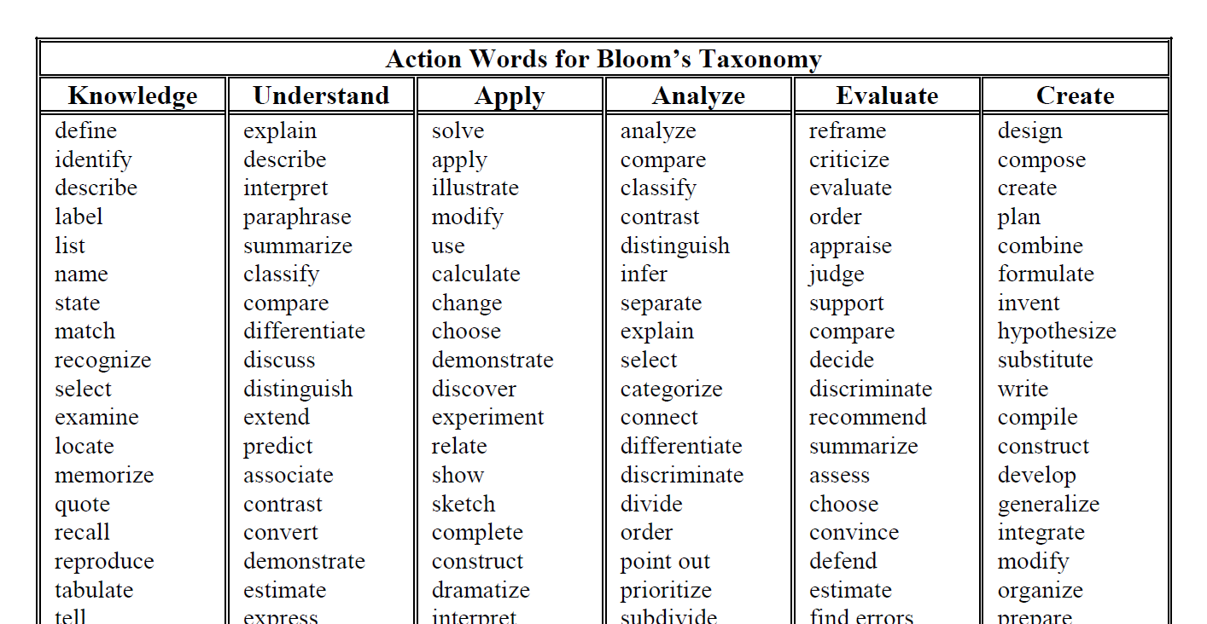
Click image to open PDF
Notes:
Vocabulary list that may be helpful in crafting research visualizations.

Slide 5
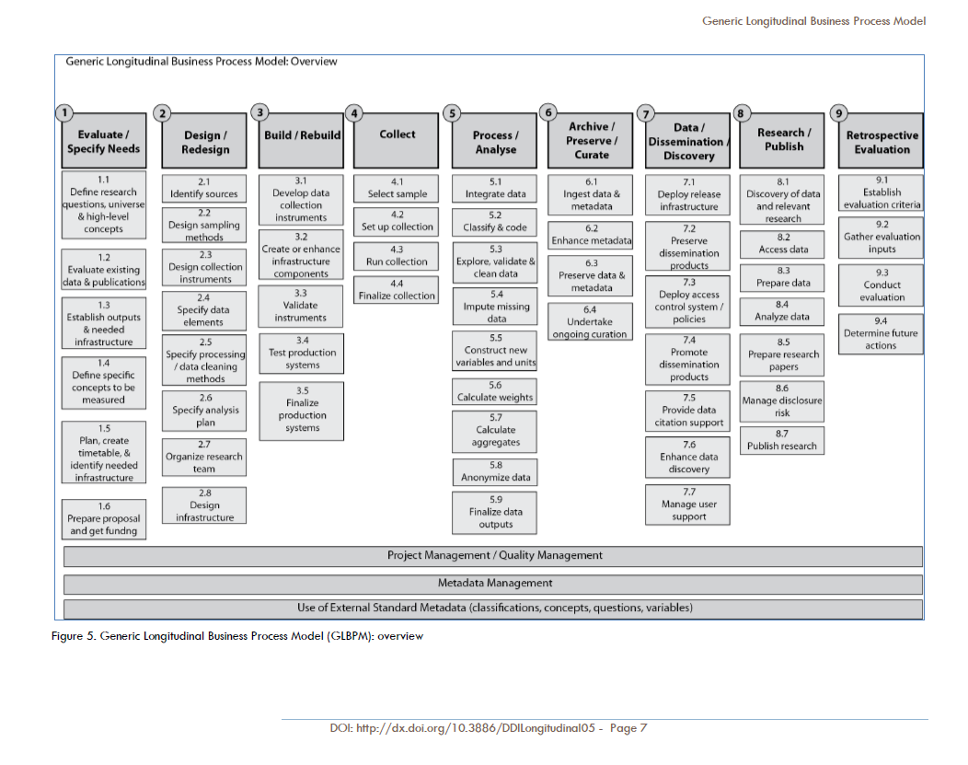
Click image to open PDF
Notes:
Generic steps in the research process which may help in deriving project needs or modeling the project.

Slide 6
Generalized Steps
Pick a template that best suits your project.
Copy the slide to a new presentation.
Add text and edit as needed.
Review/assess your graphic for simplicity and understanding.
Capture graphic and paste/crop in proposal.

Slide 7
Developing Effective Graphics For a graphic to be understood, it must:
BE READABLE. The graphic’s message must be understood in a very short time or the reader will skip it.
BE UNDERSTANDABLE. The graphic’s message must be clear without having to read the title or action caption.
MAKE A NEEDED STATEMENT. The graphic’s general message must be clear to the non-technical reader.
Source: https://www.ociwins.com/resources/blog/developing-effective-proposal-graphics-making-your-pictures-worth-a-thousand-words-64813232/.
Notes:
A simple drawing draws attention whereas a complex, detailed illustration will usually make the reader skip the graphic.

Slide 8
Evaluating Proposal Graphics: GRAPHICS SCORING: 0 – 3 Not Usable, Toss and Start Over; 4 – 5 Not Usable, Major Revisions Required; 6 – 7 Marginally Usable, Upgrade if Possible; 8 – 9 Usable; 10 Highly Usable
Graphic grabs reader’s attention in less than 10 seconds
Overall message of the graphic is understood in less than 30 seconds
Graphic message is clear without reading the title or caption
General graphic message is clear to a non-technical reviewer
Graphic presentation is logical. For example, a flow chart has clear beginning and end points
Graphic type and layout is the best way to state and sell the intended message
Message conveyed by the graphic is one the evaluator wants to see or needs to know
Graphic supplements the text with minimal redundancy and enhances the story
Caption matches the graphic, summarizes the graphic, and provides a benefit
The graphic responds to RFP requirements or sells themes/features and resulting benefits
Source: https://www.ociwins.com/resources/blog/developing-effective-proposal-graphics-making-your-pictures-worth-a-thousand-words-64813232/.

Slide 9
Timeline Templates

Slide 10
Basic Chevron Process SmartArt
2018
Research begins
2019
Data collection
More text
2020
Year 3
More text
2021
Analysis
2022
Results
More text

Slide 11
PRODUCT ROADMAP TITLE
MILESTONE TITLE
MILESTONE TITLE
Milestone description
Milestone description
20XX
Q1
Q2
Q3
Q4
MILESTONE TITLE
MILESTONE TITLE
20XX
Milestone description
Milestone description
MILESTONE TITLE
MILESTONE TITLE
Milestone description
Milestone description
Q4
Q3
Q2
Q1
20XX-20XX
3 Year Plan
MILESTONE TITLE
MILESTONE TITLE
Milestone description
Milestone description
MILESTONE TITLE
MILESTONE TITLE
Milestone description
Milestone description
Q1
Q2
Q3
Q4
20XX
MILESTONE TITLE
MILESTONE TITLE
Milestone description
Milestone description
Notes:
Too much color? Click View and select Grayscale (or Black and White) to view this template without color.

Slide 12
Add process step here
Add process step here
Add process step here
Add process step here
Add process step here
Add process step here
Add process step here
Add process step here
Add process step here

Slide 13
Timeline Infographic
Sep 2006
Add event details here
Oct 2015
Add event details here
Aug 2003
Add event details here
Mar 2012
Add event details here
May 2000
Add event details here
Jan 2009
Add event details here
2000
2005
2010
2015
Notes:
Add your own dates and event details to the flag markers. Move the flags along the timeline to match your event dates. Copy and paste a flag to add more.

Slide 14
Venn Diagrams

Slide 15
Text
Text
Text
Text
Notes:
Too much color? Click View and select Grayscale (or Black and White) to view this template without color.

Slide 16
Text
Text
Text
Text
Notes:
Too much color? Click View and select Grayscale (or Black and White) to view this template without color.

Slide 17
Text
Text
Text
Text
Text
Text
Text
Text
Notes:
Too much color? Click View and select Grayscale (or Black and White) to view this template without color.
You can customize this template with different icons. Try https://iconmonstr.com/ for free, downloadable icons (without registering for an account).

Slide 18
Concept Model Templates
“A conceptual model is an explanation, usually highly simplified, of how something works. It doesn’t have to be complete or even accurate as long as it is useful.”
From “The Design of Everyday Things: Revised and Expanded Edition”
Notes:
While your model should be as accurate as possible, it is not possible to put in ALL of the details and have a useful model.

Slide 19
Text
Text
Text
Text
Text
Text
Text

Slide 20
Text
Text
Text
Text
Text
Text
Text

Slide 21
Heading
Text
Heading
Text
Text
Heading
Text
Heading
Text

Slide 22
Heading
Text
Heading
Text
Text
Heading
Text
Heading
Text
Notes:
Too much color? Click View and select Grayscale (or Black and White) to view this template without color.

Slide 23
Year or Topic
Year or Topic
Year or Topic
Year or Topic
Year or Topic
Description here of process or step
Description here of process or step
Description here of process or step
Description here of process or step
Description here of process or step
Description here of process or step
Description here of process or step
Description here of process or step
Description here of process or step
Description here of process or step
Description here of process or step
Description here of process or step
Description here of process or step
Description here of process or step
Description here of process or step

Slide 24
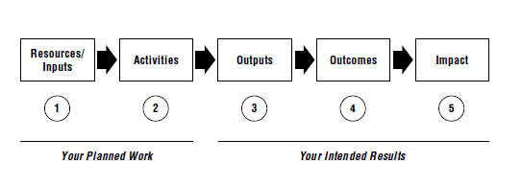
Logic Model Templates
“Basically, a logic model is a systematic and visual way to present and share your understanding
of the relationships among the resources you have to operate your program, the
activities you plan, and the changes or results you hope to achieve.”
Figure and excerpt from W.K. Kellogg Foundation Logic Model Development Guide
used with permission of the W.K. Kellogg Foundation
Notes:
[HIGHLY RECOMMENDED] A PDF of the W.K. Kellogg Foundation Guide can be found at: http://ipsr.ku.edu/grantsup/dataviz/WK_KelloggFoundation_LogicModelGuide.pdf

Slide 25
Resources/
Inputs
Activities
Outputs
Outcomes
Impact
Define human, financial, organizational, and community resources available for the project.
Summarize the processes, tools, events, technology, and actions that are an intentional part of the research implement-tation.
List the direct products of the research. Include types, levels, and targets of services, where applicable.
State the short- and/or long-term knowledge or skills anticipated to be gained as a result of the project.
Describe the fundamental change in the organization, community, or system as a result of the research.
Notes:
Adapted from the W.K. Kellogg Foundation Logic Model Development Guide.

Slide 26
Inputs
Activities
Outputs
Outcomes
Short-Term
Long-Term
Impact

